Slide 1
Introduction to Data Engineering
– Data Ingestion
Dávid Szabó

Slide 2





About the Lecturers
Péter Megyesi
Assistant Professor
Dávid Szabó
Assistant Professor
Attila Papp
Phd Student
petermegyesi@inf.elte.hu
davidszabo@inf.elte.hu
attila.papp@inf.elte.hu
linkedin.com/in/M3gy0
linkedin.com/in/szabvid
linkedin.com/in/atipapp

Slide 3
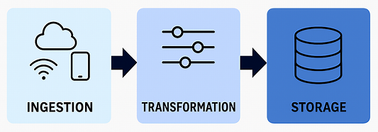
Data Pipelines – 3 Stage Model
A data pipeline is a series of tools and processes that move data from one or more sources to a destination.
It includes ingestion, transformation, and delivery of data.
These pipelines are essential for enabling analytics, reporting, machine learning, and other data-driven operations.
Notes:
A data pipeline is a series of tools and processes that move data from one or more sources to a destination.
It includes collection, processing, transformation, and delivery of data.
Think of it as the digital equivalent of an oil pipeline—moving raw material (data) to where it can be refined and used.

Slide 4
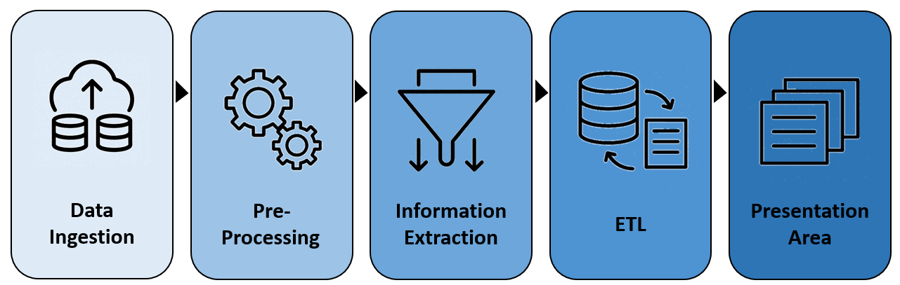
Data Pipelines – 5 Stage Model
The architecture of a data pipeline is not rigid or universal.
It’s a flexible framework that should be tailored to the specific needs of your system, your data sources, and your business goals.
Key takeaways:
  No one-size-fits-all: A pipeline for real-time fraud detection will look very different from one built for monthly financial reporting.
  Stages can blur: Ingestion might include light transformation; ETL might include pre-processing; monitoring might be embedded across all layers.
  Tools influence structure: Using cloud-native tools like dbt (Data Build Tool) or Airflow may collapse or expand stages depending on orchestration and modularity.
  What matters is who owns each boundary and what it guarantees.
These pipelines are essential for enabling analytics, reporting, machine learning, and other data-driven operations.

Slide 5
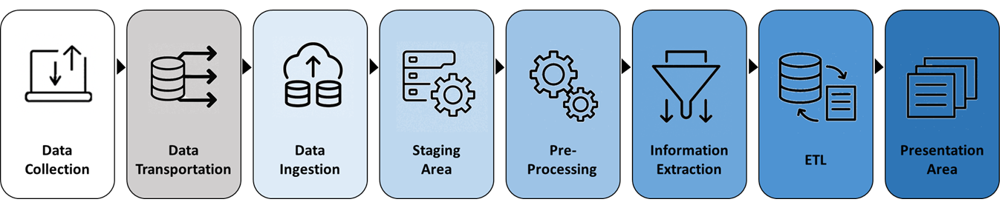
Where Does Ingestion Begin? — Data Collection
Generation or capture of data at its source
Typically occurs inside applications, devices, or operational systems:
  A CRM records a customer update
  A mobile application records a user interaction
  A sensor emits a temperature reading
May be passive (logs, telemetry) or active (forms, transactions)
Often owned by product teams or app teams not by data engineers; ownership varies by organization
Notes:
Examples:
A CRM system logs customer updates
A mobile app tracks user clicks
A temperature sensor emits readings every second
Speaker Notes:

Slide 6
Where Does Ingestion Begin? — Data Transportation
Moves collected data toward the data platform
Data may be transferred continuously as it arrives (Kafka, MQTT), or periodically in batches (SFTP)
Uses protocols, queues, event logs, connectors, or file transfer
Maybe owned by infra teams or shared with data engineers
Examples:
  Kafka carries events from applications to a durable topic
  Azure Data Factory copies files from SFTP to Blob Storage
  MQTT transports IoT telemetry using a lightweight publish/subscribe protocol
Notes:
Explain that transportation is the logistics layer — it ensures reliable delivery, but doesn’t inspect or store the data. It’s the bridge between collection and ingestion.

Slide 7
Where Does Ingestion Begin? — Data Ingestion (Platform Entry)
Often forms the first boundary owned by a data platform team
Collection is external dependency
Transportation is a gray zone — sometimes tightly coupled with ingestion
Creates an explicit hand-off with defined guarantees:
  Performs the technical validation required for safe landing
  Adds ingestion metadata and operational telemetry
  Persists source-faithful data in a raw landing or Bronze area
Exact responsibilities vary, but business transformation is usually deferred

Slide 8
Collection vs Transportation vs Ingestion
Step | Primary responsibility | Temperature-reading example
Collection | Capture data at the source | A sensor measures 22.4 °C
Transportation | Move data toward the platform | The reading is sent over the network
Ingestion | Accept, identify, and persist | The platform stores the reading with its sensor ID and time
Another example:
Collection = taking a photo
Transportation = uploading it to cloud
Ingestion = saving it in your photo library with metadata (e.g. identity, time)

Slide 9
Types of Data Ingestion („When”) – Batch Ingestion
Data is collected and ingested at scheduled intervals (e.g., hourly, daily)
Characteristics:
  Simpler to implement
  Higher latency
  Often used for historical or slowly changing data
Examples:
  🏦 Banking – Daily transaction logs exported from core banking systems to a data warehouse
  🛒 Retail – Nightly sales data from POS systems uploaded as CSVs to Azure Blob Storage
  🧾 Finance – Monthly financial reports ingested from Excel files into Power BI
  🧬 Healthcare – Weekly patient records exported from EMR systems for compliance reporting
  📊 Marketing – Scheduled pulls of campaign performance data from Google Ads API
Notes:
diagram: Timeline showing data arriving at fixed intervals

Slide 10
Types of Data Ingestion („When”) – Streaming Ingestion
Data is ingested continuously as it is generated, often in near real-time.
Characteristics:
  Low latency
  Requires event-driven architecture
  Enables real-time analytics and alerting
Examples:
  🚗 IoT – Vehicle telemetry streamed via MQTT into Azure Event Hubs
  🕵️‍♂️ Fraud Detection – Credit card transactions streamed into Flink for anomaly detection
  📰 News Aggregation – RSS feeds ingested in real time to update dashboards
  🎮 Gaming – Player actions streamed from game servers into Kafka for live leaderboards
  🏥 Healthcare – Real-time monitoring of ICU vitals streamed to alerting systems
Notes:
Diagram: Live data flow with arrows and event icons

Slide 11
Types of Data Ingestion („When”) – Hybrid Ingestion
Combines batch and streaming to balance latency, complexity, and cost.
Characteristics:
  Maintains both low-latency and complete historical paths
  Combines different ingestion modes for different source and consumer needs
  Costs more to build and operate than a single ingestion mode
Examples:
  🏢 Smart Buildings – Real-time sensor alerts + hourly environmental summaries
  🛍️ E-commerce – Live clickstream data + daily product catalog updates
  📦 Logistics – Real-time package tracking + nightly route optimization reports
  📱 Social Media – Live post ingestion + nightly sentiment analysis on aggregated data
Notes:
Diagram: Split diagram showing batch and stream paths converging
Emphasize that the choice of ingestion type depends on:
Business requirements (e.g., real-time alerts vs historical analysis)
Data velocity and volume
Tooling and infrastructure
Cost and complexity trade-offs

Slide 12
Methods of Data Ingestion („How”)
Ingestion methods define how data is delivered to the platform
Can be used in batch, streaming, or hybrid contexts
Choice depends on source system, latency needs, and tooling
  🧩 File-based ingestion:
    Common formats include CSV, JSON, Parquet, and spreadsheets
    Files may be delivered through SFTP or object storage
    Common for scheduled batch ingestion
    Example: monthly HR data delivered as an Excel file
  🌐 API-based ingestion:
    REST or GraphQL APIs are typically pulled by the data platform
    Webhooks push event notifications to a receiving endpoint
    Can support batch (pull) or event-driven (push)
    Example: receiving payment events through a Stripe webhook

Slide 13
Methods of Data Ingestion („How”)
Ingestion methods define how data is delivered to the platform
Can be used in batch, streaming, or hybrid contexts
Choice depends on source system, latency needs, and tooling
  🔄 Database connectors:
    Queries read snapshots or incremental ranges from database tables
    Change Data Capture (CDC) captures inserts, updates, and deletes from a database change log
    Supports batch and continuous ingestion
    Example: replicating order changes from an operational database to a data lake
  🔊 Message queues:
    Applications and devices publish messages or events for downstream consumers
    Queues distribute messages among consumers
    Common for streaming ingestion
    Example: sensors publish temperature readings to an MQTT broker

Slide 14
Methods of Data Ingestion („How”)
Ingestion methods define how data is delivered to the platform
Can be used in batch, streaming, or hybrid contexts
Choice depends on source system, latency needs, and tooling
  🧪 ETL/ELT:
    Airbyte, Fivetran, Azure Data Factory
    These tools often span multiple stages of the pipeline
    Often used for batch ingestion, but some support streaming or micro-batch
    Example: Azure Data Factory copies data from FTP, REST APIs, or SQL into Blob Storage or Synapse

Slide 15
Mapping Ingestion Methods („How”) to Ingestion Types („When”)
Ingestion Method | Batch | Streaming | Typical role in a hybrid design
File-based (CSV, JSON) | Typical | Uncommon | Historical loads and large backfills
REST API (pull) | Typical | Possible via polling | Periodic reconciliation and recovery of missed records
Webhooks | Possible after buffering | Typical | Real-time notifications, paired with periodic reconciliation
Messaging and event streams | Possible | Typical | Continuous event delivery, paired with batch backfills
ETL/ELT and data integration tools | Tool dependent | Tool dependent | May coordinate both paths, depending on the tool
Choosing the Right Ingestion Method
  🔍 Source system capabilities: Does it support push or only pull?
  ⏱️ Latency requirements: Real-time vs daily updates?
  🧰 Tooling and infrastructure: What connectors or platforms are available?
  📊 Data format and volume: Structured vs semi-structured, small vs large
  🔐 Security and governance: Authentication, encryption, auditability

Slide 16
What Ingestion Does and Doesn’t Do? – Boundaries
Always expected
  Receive and technically parse the payload
  Identify source, schema, and ingestion time
  Persist data durably and emit operational telemetry
Sometimes required for safe landing
  Decrypt, decompress, validate an envelope, or mask prohibited sensitive data
  Perform technical deduplication when the transport contract requires it
Usually deferred to processing
  Null imputation, outlier treatment, joins, enrichment, and business calculations
The boundary may vary; document it as part of the producer–consumer contract.

Slide 17
Common Ingestion Challenges
Latency: How long until source data becomes usable?
Throughput and source limits: Can both ends sustain the required rate?
Schema drift: What happens when fields or types change?
Delivery failures and retries: What happens if an ingestion run stops halfway?
Duplicates and ordering: Can retries create duplicates, or parallel delivery change record order?
Observability: Can we prove what arrived, what failed, and what is missing?
Examples:
  An ingestion job fails after writing only some records returned by an API
  A file is uploaded twice under different names
  A producer changes temperature from number to string
Design goal: make failures visible and reruns safe.

Slide 18
Schema Drift: Compatible Change or Broken Contract?
Schema drift is a change in fields, types, nullability, or structure.
Schema drift is quite natural in real-world systems and not every change has the same risk.
Usually compatible
  Add an optional field; widen a numeric type when consumers support it
Potentially breaking
  Rename or remove a field; add a required field; change string to integer
Possible responses
  Accept and version, transform through an adapter, quarantine, or fail fast
Schema drift can be managed through:
  versioning, compatibility rules, and validation during ingestion
  schema-on-read adds flexibility but shifts validation to read time.
Notes:
Clarify that schema registries are one implementation of schema governance — but the need to manage schemas exists across all platforms. Encourage students to think about where schema is enforced in their pipeline: at ingestion, processing, or storage.

Slide 19
Managing Schema Evolution — Data Contract Example
A data contract makes the producer–consumer agreement explicit before data arrives.
Example event:
  {"sensor_id":"S-17", "event_time":"2026-09-10T08:15:00Z", "temperature_c":22.4}
The agreement defines:
  Schema — sensor_id is a required string; temperature_c is a number
  Semantics — temperature is Celsius; event_time is the measurement time in UTC
  Operations — one event per minute; events may arrive up to five minutes late
  Evolution — optional fields are compatible; renaming a field requires version 2
  Ownership — the IoT team produces the event; the data platform owns ingestion
A contract does not prevent change; it makes change intentional and observable.

Slide 20
What is a Staging Area?
A durable landing zone for ingested data
Stores data in its raw or minimally processed form (plus ingestion metadata)
Decouples source availability from downstream processing
Enables replay, schema-on-read, reprocessing, and lineage tracking
Often implemented using cloud storage (e.g., Azure Blob, S3, HDFS)
“Staging” describes its role; it does not necessarily mean short-lived.
* HDFS (Hadoop Distributed File System): scalable, fault-tolerant file system designed to store and manage large volumes of data across multiple machines
Notes:
Explain that the staging area is the first place data lands after ingestion. It’s not meant for analytics — it’s meant for safety, traceability, and flexibility.

Slide 21
What is a Staging Area?
Examples:
  Azure Blob container for raw JSON files:
    A Kafka Connect job writes raw JSON logs to Azure Blob Storage /bronze/logs/2025/08/31/
  HDFS directory with timestamped CSV dumps
  S3 bucket with partitioned folders by date/source
* HDFS (Hadoop Distributed File System): scalable, fault-tolerant file system designed to store and manage large volumes of data across multiple machines
Notes:
Explain that the staging area is the first place data lands after ingestion. It’s not meant for analytics — it’s meant for safety, traceability, and flexibility.

Slide 22
Why Use a Staging Area?
Decouples ingestion from processing
Reprocess data when transformation logic changes
Backfill downstream products without querying the source again
Reconcile what the source sent with what the platform produced
Isolate ingestion failures from processing failures
Support audit, lineage, retention, and incident investigation
Trade-off: raw retention consumes storage and increases governance responsibility.
Notes:
Use a real-world analogy: staging is like a warehouse receiving dock — goods arrive, get tagged, and wait to be sorted.
Diagram: Show ingestion → staging → processing flow with metadata tagging

Slide 23
Designing a Staging Area — Six Principles
Preserve and replay
  1. Keep landed objects append-only; store corrections as new versions
  2. Preserve the source representation or use a documented lossless envelope
Organize and explain
  3. Partition by stable, useful dimensions such as source and ingestion date
  4. Record technical metadata for every object and ingestion run
Govern and scale
  5. Define access control, encryption, retention, and deletion policies
  6. Avoid tiny files and high-cardinality directory structures
Notes:
Show a folder structure like /staging/sales/2025/08/31/source=POS/ and explain how it supports traceability and scalability.

Slide 24
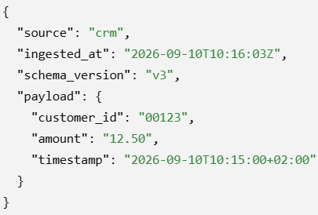
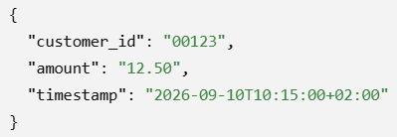

Designing a Staging Area — Six Principles
Preserve and replay
  1. Keep landed objects append-only; store corrections as new versions
    run_id=001/orders.csv → run_id=002/orders_correction.csv
    Never silently overwrite evidence needed for audit or replay.
  2. Preserve the source representation or use a documented lossless envelope
    Add ingestion metadata around an unchanged payload.
2A. Original source payload
2B. Potentially lossy simplification
2C. Lossless envelope
Leading zero, numeric scale, and timezone representation are lost.
Notes:
Show a folder structure like /staging/sales/2025/08/31/source=POS/ and explain how it supports traceability and scalability.

Slide 25
Designing a Staging Area — Six Principles
Organize and explain
  3. Partition by stable, useful dimensions such as source and ingestion date
    /bronze/sales/source=pos/ingestion_date=2026-09-10/run_id=042/part-0001.json
    source identifies the producer; ingestion_date narrows time-based reads; run_id isolates one load
    Avoid high-cardinality directory keys such as customer_id or transaction_id
  4. Record technical metadata for every object and ingestion run
    run_id, source, ingested_at, schema_version, checksum, byte_size, record_count, status
    A manifest explains how a load happened; folders help navigation but are not authoritative metadata
Notes:
Show a folder structure like /staging/sales/2025/08/31/source=POS/ and explain how it supports traceability and scalability.

Slide 26
Designing a Staging Area — Six Principles
Govern and scale
  5. Define access control, encryption, retention, and deletion policies
    Example: only the ingestion identity can write to Bronze; analysts use curated layers
    Encrypt data and define when sensitive raw exports must be archived or deleted
    Azure examples: ADLS access control and Blob Storage lifecycle policies
  6. Avoid tiny files and high-cardinality directory structures
    Bad: one 2 KB file and one directory for every customer event
    Better: group records into larger objects under stable source/date partitions
    If compaction is needed, create a derived optimized copy instead of overwriting raw evidence
Notes:
Show a folder structure like /staging/sales/2025/08/31/source=POS/ and explain how it supports traceability and scalability.

Slide 27
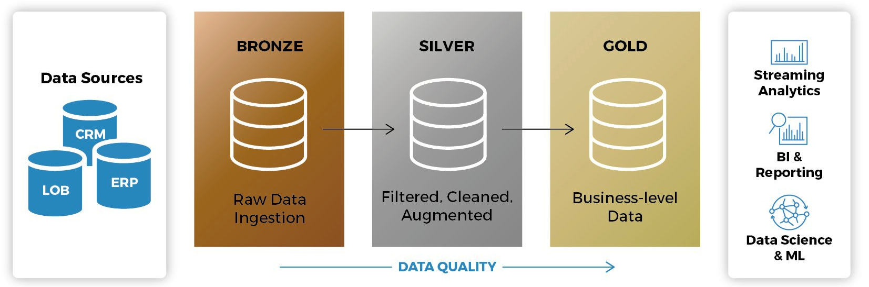
What Is Medallion Architecture?
A logical pattern for refining data through layers with different guarantees
Common names are Bronze, Silver, and Gold
Separates source-faithful data, validated data, and consumer-oriented models
Does not prescribe one cloud, processing engine, file format, or directory structure
The layer names are conventions; their contracts and quality guarantees matter more.
Notes:
https://blog.bismart.com/en/medallion-architecture

Slide 28
What Is Medallion Architecture?
Bronze Layer – Source-Faithful Data:
  Directly ingested from source systems
  Preserves the original payload or a documented lossless envelope (e.g. in JSON, CSV format)
  Adds technical metadata and only the validation needed for safe landing
  Supports replay, audit, and future interpretation
  Often—but not always—the raw landing or staging area
  Example:
    IoT sensor events under /bronze/sensor_events/ingestion_date=.../

Slide 29
What Is Medallion Architecture?
Silver Layer – Validated and Conformed Data:
  Deduplicated, typed, validated, and standardized
  Applies schema and data-quality policies
  May reconcile sources or enrich with reference data
  Provides reusable, stable inputs for downstream processing
  Business-sensitive cleansing typically begins here, although boundaries vary
  Example:
    Valid sensor events with UTC timestamps and standardized units

Slide 30
What Is Medallion Architecture?
Gold Layer – Consumer-Oriented Data:
  Aggregated or modeled for a defined analytical or operational use
  May use dimensional, wide-table, feature, or API-oriented models
  Carries clear business semantics and service expectations
  Optimized for consumer usability and access patterns
  Not every pipeline needs a Gold layer or exactly three layers
  Example:
    Hourly sensor health metrics by location and device type

Slide 31
Lab Preview: Two Sources, One Bronze Contract
The lab deliberately uses two simple ingestion paths:
  A bounded CSV file drop
  A pull from a REST API returning JSON
Both land under a consistent Bronze layout with source and date metadata.
You will introduce a schema change and inspect what should be accepted or rejected.
Outputs include a raw object, run manifest, and validation report.
Azure Blob Storage is the implementation; the design principles are cloud-agnostic.
CSV Export
REST API
Schema v2
. . .
file
JSON
change
Bronze Storage
Run Manifest
Validation Report
. . .

